Slide 1
Profile-based System for Nutritional Information Management
Rui Costa, Catarina Silva, Luis Marcelino
Polytechnic Institute of Leiria
October 2013

Slide 2

Introduction
Lifestyle in modern societies
Stressful work life
Lack of time to exercise
Inadequate diet
Profile-based System for Nutritional Information Management

Slide 3

Introduction
Profileration of medical conditions requiring strict dietary restrictions
Diabetes, hypertension, allergies...
WHO alerts for the increase of high blood pressure, diabetes and obesity.
Jornal Público (16/05/2012)
Profile-based System for Nutritional Information Management

Slide 4
Objectives
Make use of information technologies to improve the general population lifestyle
Propose a solution allowing people to obtain informed food choices falling in their profile
Dietary restrictions
Dietary options
Profile-based System for Nutritional Information Management

Slide 5
State of the Art
Nutritional control
Works that address the nutritional control topic by recording the food consumed by people
Shopping assistants
Intelligent/automated shopping assistants
Profile-based System for Nutritional Information Management

Slide 6
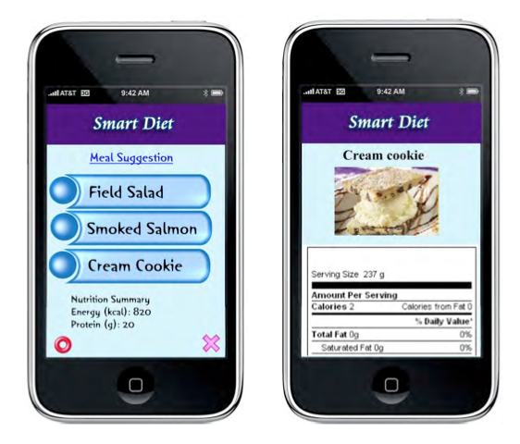
State of the Art
Nutriotional control: Meal Planner
Suggestions of meals in restaurants nearby
Multi-objective optimization, taking into account the user localizations, the nutritional restrictions of several profiles (diabetic people, healthy people) and the user consumption history
Only meal suggestions from restaurants
Users don’t have access to their meal history
Profile-based System for Nutritional Information Management

Slide 7
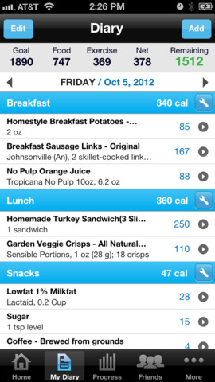
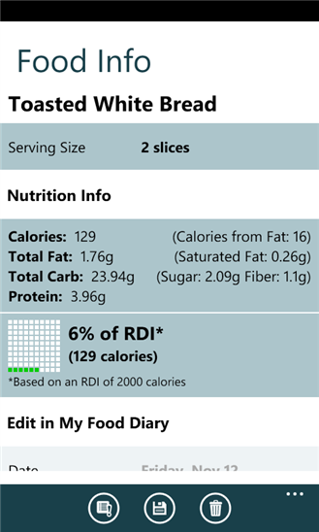
State of the Art
Nutritional control: MyFitnessPal and Calorie Counter
Using the concept of a diary where user records the calorie consumption throughout the day
Definition of a goal to achieve (loss weight, maintain weight, etc)
Users aren’t provided any food recommendations: the application only cares about calorie consumption
Profile-based System for Nutritional Information Management

Slide 8
State of the Art
Nutricional control – conclusions
Several scientific papers and applications in this area
In general, the approach taken consists in recording the several meals throughout the day in a food diary
Definition of a goal to achieve
The main concern is the amount of calories ingested
Profile-based System for Nutritional Information Management

Slide 9
State of the Art
Shopping assistants: ShopGenie
Shopping lists management
Price check and comparison
Possibility to determine the distance from the products inside the store
Mainly focused on commercial purposes
Windows Mobile platform, already deprecated
Profile-based System for Nutritional Information Management

Slide 10
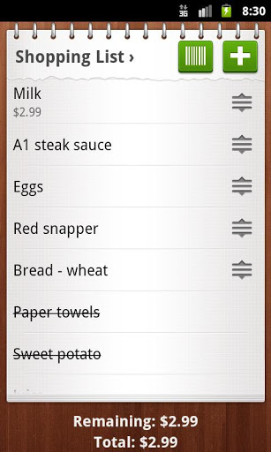
State of the Art
Shopping assistants: Out of Milk Shopping List
Popular app in Google Play Store
Shopping lists management
Identification of products in the existing database via barcode scanning
Alternative to the use of paper and pen
Profile-based System for Nutritional Information Management

Slide 11
State of the Art
Shopping assistants – conclusions
There are also several scientific papers and applications addressing the shopping assistants topic
Mainly focused in comercial purposes
Price comparison
Locate products inside the store
Shopping lists management
The applications available in online stores are just simple apps to manage user’s shopping lists
The area of nutritional recommendation and food counseling is not properly explored yet
Profile-based System for Nutritional Information Management

Slide 12
State of the Art
There is room for the development of a solution combining both areas:
Nutritional control
Shopping assistants
“Smart shopping list assistant”
Definition of users’ individual nutritional profile
Food recommendations based on that profile
Profile-based System for Nutritional Information Management

Slide 13
Proposed solution
Key concepts
Item: product stored in the database and can be contained in one or more categories. i.e. “Cheese brand X 50 grams" or "Soya Milk brand Y 1L”
Category: class where an item fits; can be organized in an hierarchical structure
Property: one of the characteristics which identify an item. Each item has a set of properties, i.e. the percentage of DRI (Dietary Reference Intake) of proteins or salt, the product price, etc.
Unit: a property has an associated unit. i.e. given the previous example, the unit "Euros" for the product price, and the unit "Percentage" to represent the DRI of proteins and salt
Profile-based System for Nutritional Information Management

Slide 14
Proposed solution
Key concepts
Profile: set of properties and their respective values that characterize the profile. The values of each property can be exact values or ranges of values, and represent a rule mapped in the profile.
Profile-based System for Nutritional Information Management

Slide 15
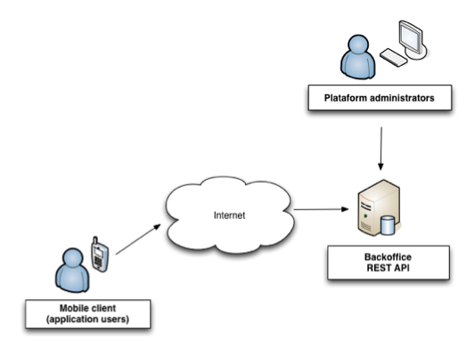
Proposed solution
High level overview
Profile-based System for Nutritional Information Management

Slide 16
Proposed solution
Mobile client functionalities
Nutritional profile definition/import existing templates
Manage shopping lists
Navigation through existing products database
Food filtering based on the rules defined in the profile
Server
Comunication with mobile client
Data management through a web backoffice
Profile-based System for Nutritional Information Management

Slide 17
Tests
Focused on determine if the concepts introduced by the application were clear for the users
8 people – all smartphone users – aged between 21 and 29 years old were invited to test the application
An environment was setup simulating a real use of the application (containing real products, properties, units and profiles)
Profile-based System for Nutritional Information Management

Slide 18
Tests
A script containing a predefined set of tasks was created
1. Import and a configure a profile called “Light products” from the server;
2. Create a new shopping list based on a previous shopping list kept in the historic;
3. Add a specific product the shopping list which fits in the “Light Products” profile;
4. Add a product through barcode scanning;
5. Add a specific product not fitting in the “Light Products” profile;
6. Assuming that not all products were available in the supermarket, register that information in the shopping list and archive it in the historic.
Profile-based System for Nutritional Information Management

Slide 19
Results
In general, all testers felt comfortable and curious to explore the application interface
In some cases, users insisted in repeating some of the tasks more than once
Users had no problem to complete the shopping related tasks using different strategies (filtered list, barcode scanning and unfiltered product list)
Some confusion while performing administrative tasks such as importing profiles form the server or archiving a shopping list
Profile-based System for Nutritional Information Management

Slide 20
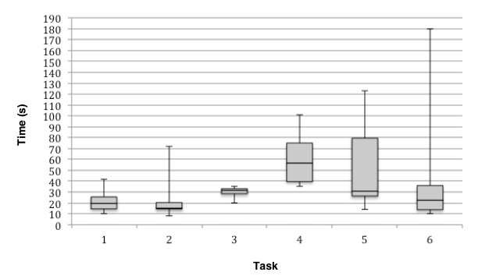
Results
Distribution of times (in seconds) users took to complete each task
Profile-based System for Nutritional Information Management

Slide 21
Conclusions
The area of nutritional advice and counseling hasn’t been properly explored
Room for a solution combining both areas of shopping assistants and nutritional control
The preliminary tests suggest that applying profiles through simple filters may not be appealing to users
Users were enthusiastic to test regular shopping features and not so much to take advantage from the profiling mechanism
Profile-based System for Nutritional Information Management

Slide 22
Future work
Integration of the existing product database with a real retail chain supplier
Large database of products and characteristics
Up to date information
Provide statistics adapted to the specific profile in use
Profile-based System for Nutritional Information Management

Slide 23

Questions?
Profile-based System for Nutritional Information Management

